Slide 1
WELCOME

Slide 2
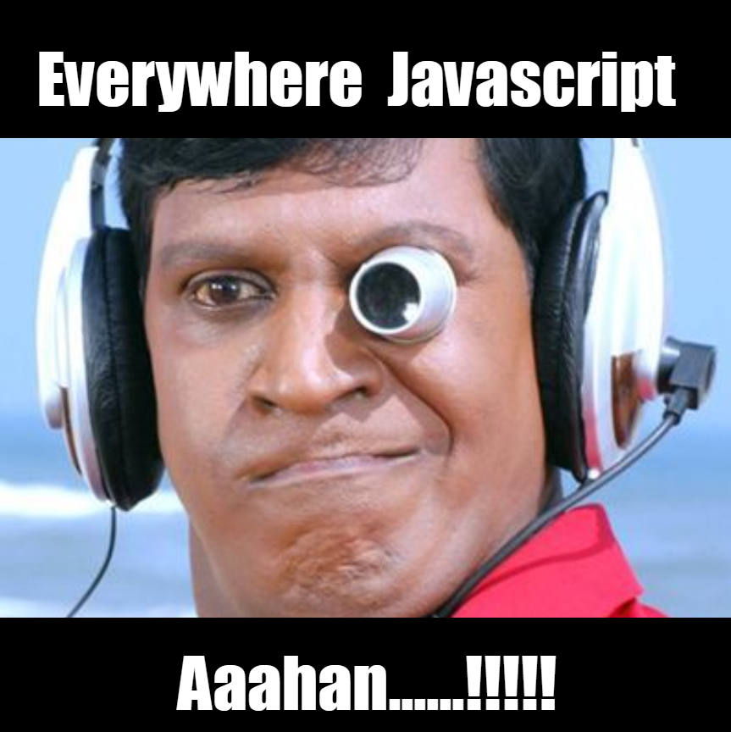
Question :
1) [1, 2, 3] + [4, 5, 6] = ?
2) "b"+"a"+ +"n"+"a“ =?
3) 5+true = ?
4) 5 == ‘5’ ?
5) 5 === ‘5’ ?

Slide 3
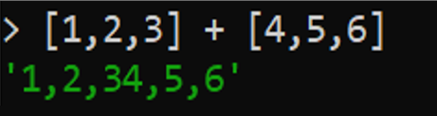
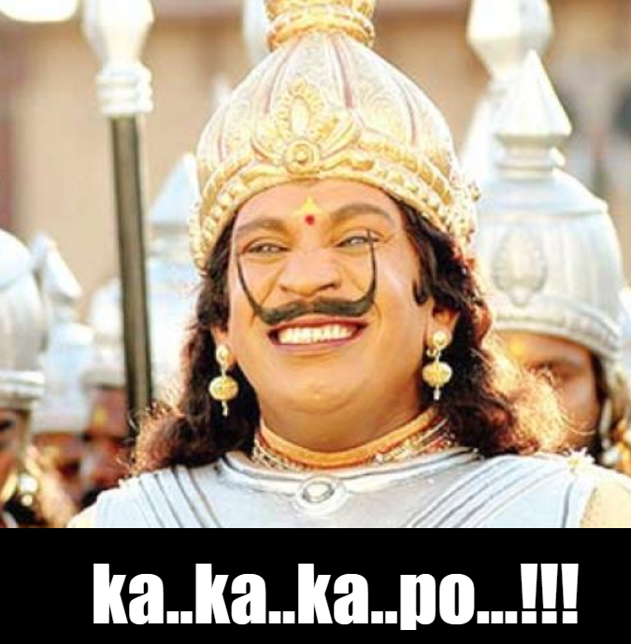
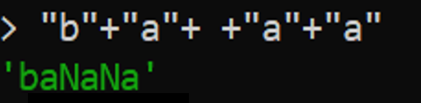
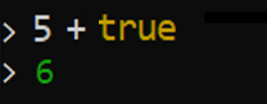

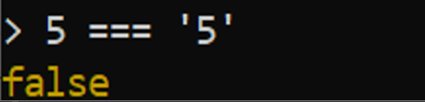

Slide 4

Thinking In Node JS

Slide 5
Agenda
What is Node JS & Architecture
Why
Node.js User Survey Report
Event Loop
Package Manager
Where to Use (! Not)
Popular Frameworks in Node JS

Slide 6
What Is Node JS
Server Side Javascript
JavaScript runtime built on Chrome's V8 JavaScript engine
Lightweight and Efficient
Event Driven, Works on Non-Blocking Model
Can Handle Thousands of Concurrent Connections with Minimal Overhead on a Single Process

Slide 7

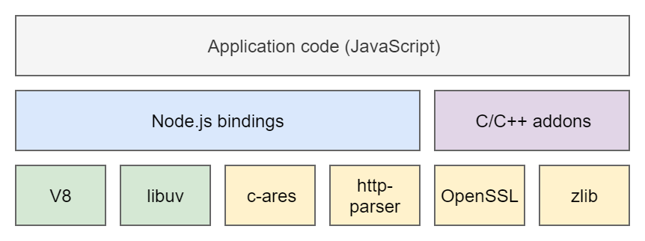
Building Block

Slide 8
WHY

Slide 9
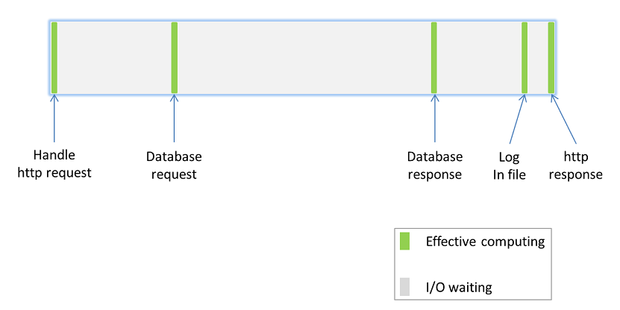
PROBLEMATIC

Slide 10
CONVENTIONAL SOLUTION
MULTI-THREADING
Context switching overhead
Memory consumption
Manage concurrency
Dead lock
MULTI PROCESSES
High memory usage
Process scheduling overhead
and always waiting I/O...

Slide 11
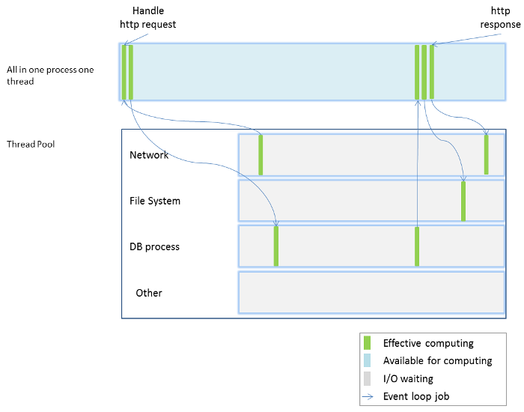
NODE.JS ANSWER
SCALE WITH EVENT LOOP

Slide 12
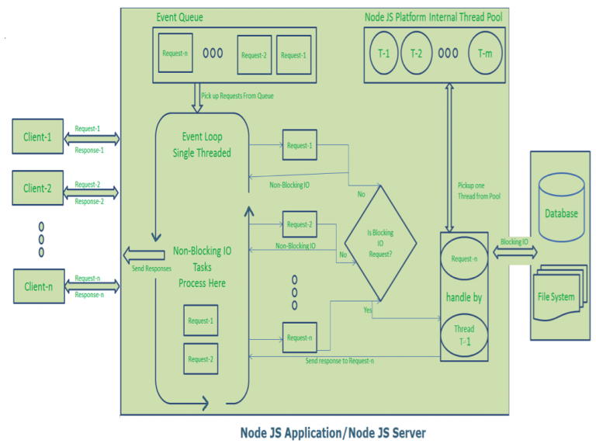
Event Loop Theory
Delegate I/O part and manage callbacks

Slide 13
NPM
NPM is the default package manager for Node.js.
It manages dependencies for an application.
It also allows users to install Node.js applications that are available on the npm registry.

Slide 14
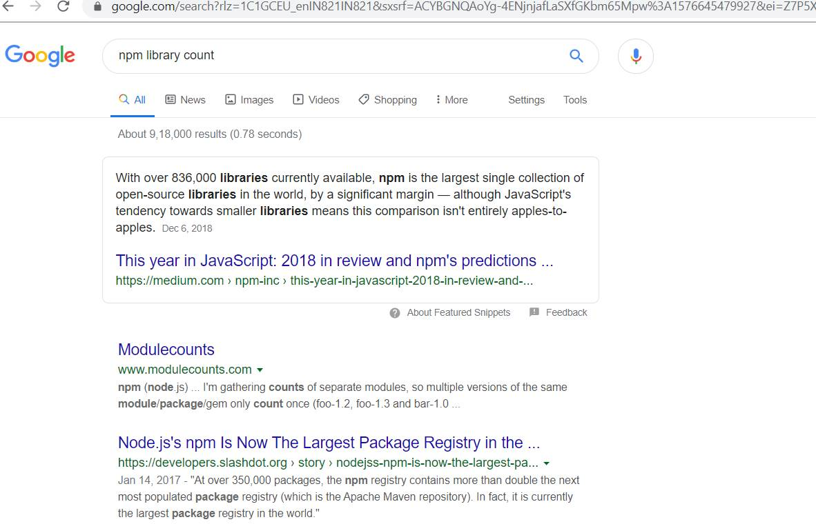

Slide 15
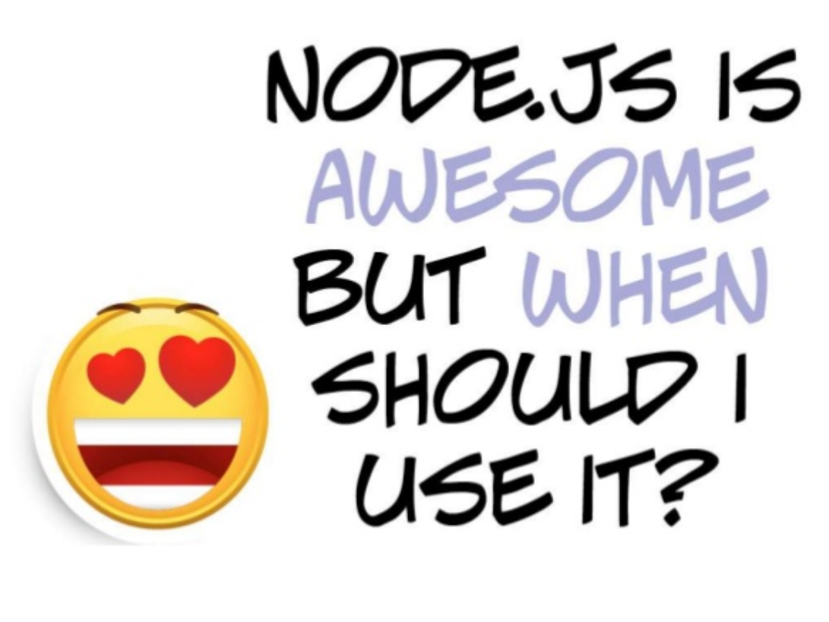
Where to Use NodeJS
Few CPU Cycles
I/O Operations
Chat/Messaging
Real Time Applications
Communication Hubs
High Concurrency Applocations

Slide 16
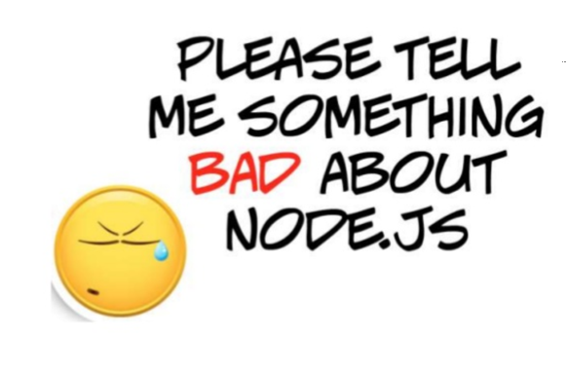
Where you Cannot Use NodeJS..?
Heavy computation
Large and complicated web applications

Slide 17
FEW METRICS

Slide 18
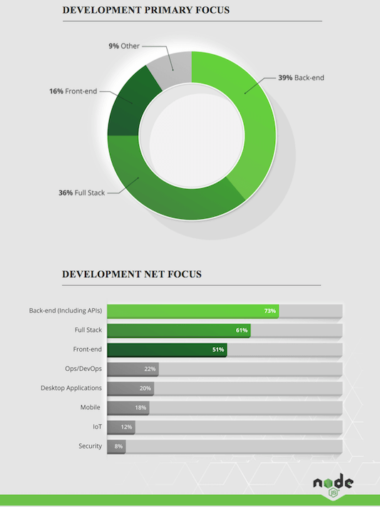
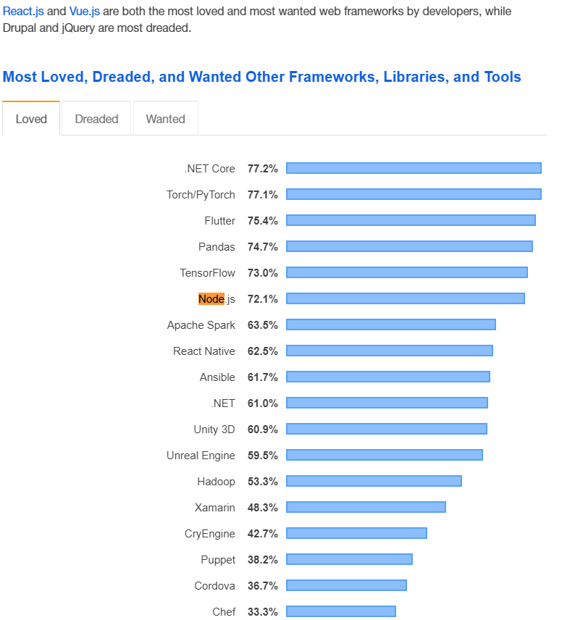

Slide 19
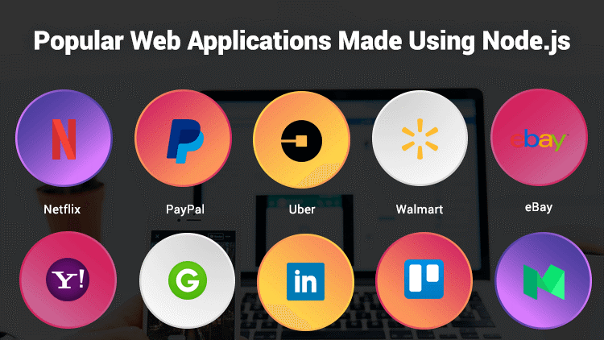

Slide 20
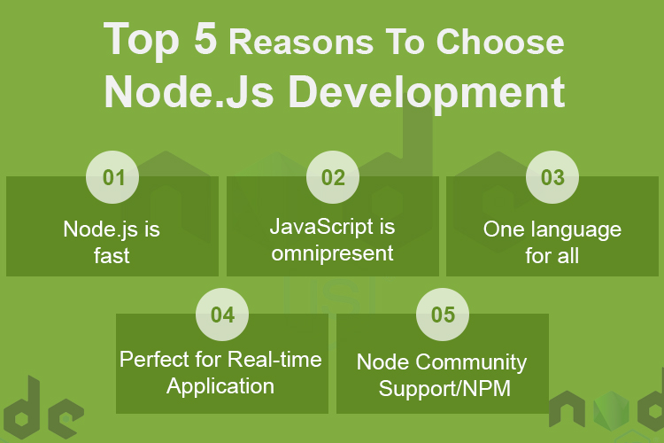

Slide 21
10 NodeJS Frameworks to Use in 2019
Node.js frameworks are mostly used because of their productivity, scalability and speed, making them one of the first choice for building enterprise applications for companies.
Express.js [GitHub Stars: 41,036]
Meteor.js [GitHub Stars: 40,490]
Koa.js [GitHub Stars: 23,902]
Sails.js [GitHub Stars: 19,887]
LoopBack.js [GitHub Stars: 11,985]
Hapi.js [GitHub Stars: 10,371]
Nest.js [GitHub Stars: 10,128]
AdonisJs [GitHub Stars: 5,053]
Derby.js [4,350]
Total.js [GitHub stars: 3,853]

Slide 22
Live Coding

Slide 23
